Slide 1
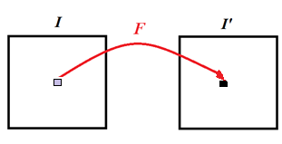
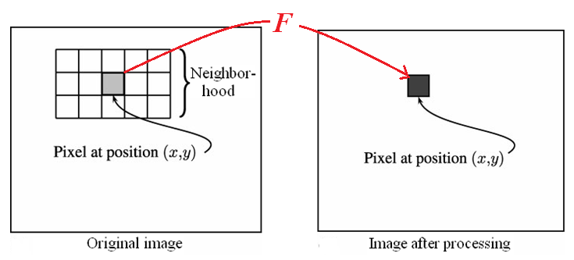
Chapter 4: Point Processing
Image processing: Transforms the values of pixels
Two classes of processing:
Point processing: applies a function to each pixel
Neighborhood processing: applies a function to a
neighborhood of each pixel
4-<number>
Notes:
point processing- 不管周圍

Slide 2
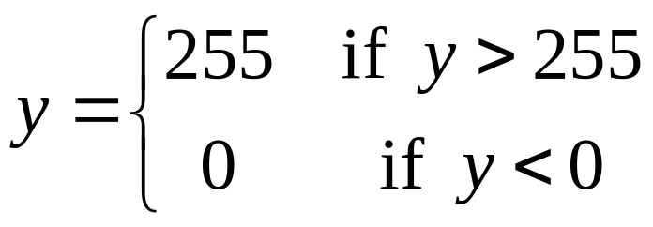
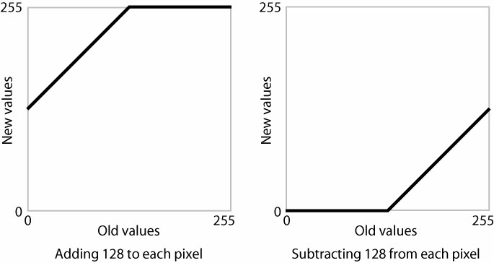
◎ Point processing y = f(x)
○ Addition and subtraction
y = f(x) = x + C, y = f(x) = x － C
Example: C = 128
4-<number>

Slide 3
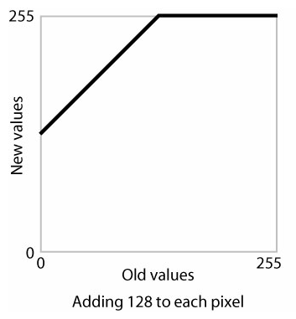
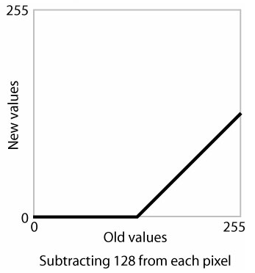
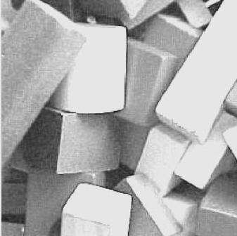
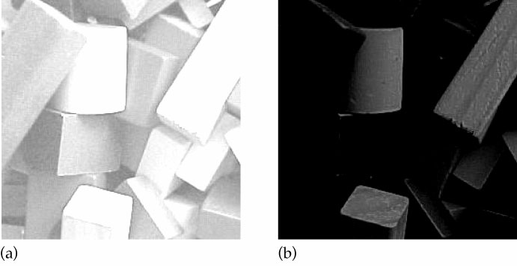
Input image
4-<number>

Slide 4
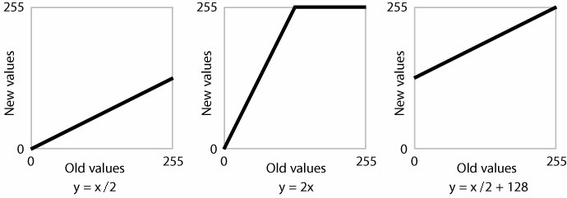
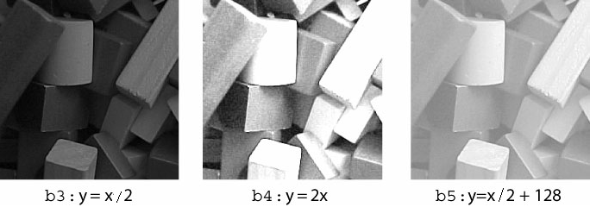
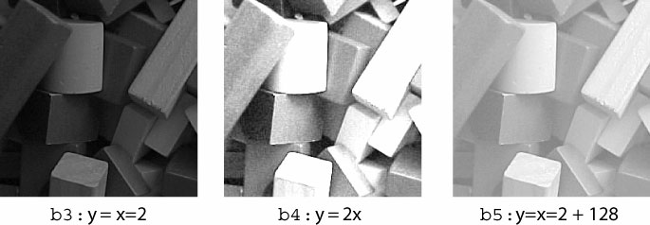
○ Multiplication y = f(x) = Cx
負片(要轉成正片)
4-<number>

Slide 5
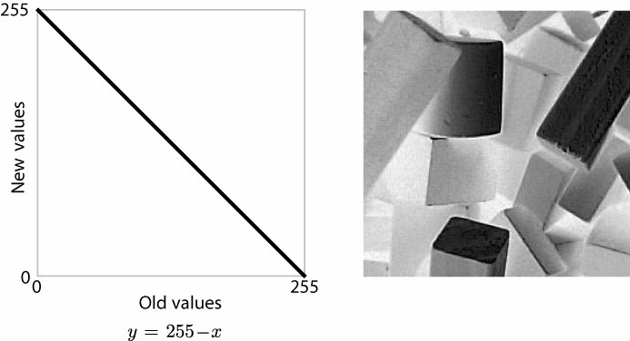
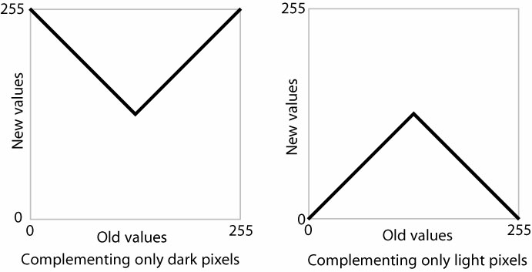
○ Complementation y = 255 － x
○ Solarization
4-<number>

Slide 6
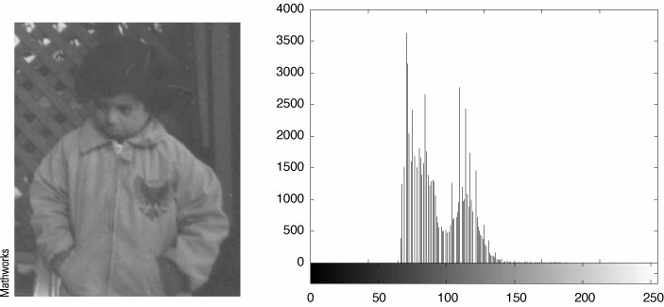
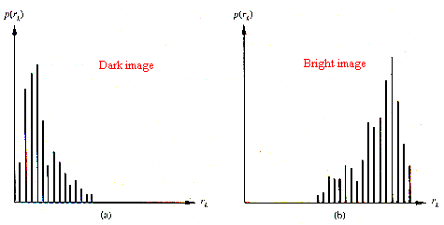
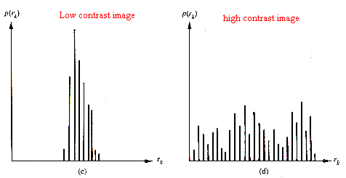
4.3 Histogram
4-<number>
Notes:
分布的很散看起來比較好

Slide 7
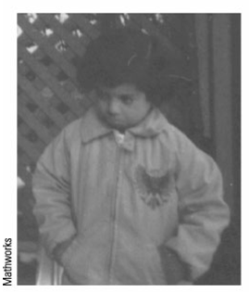
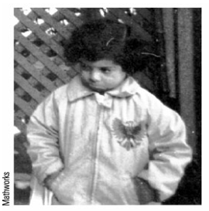
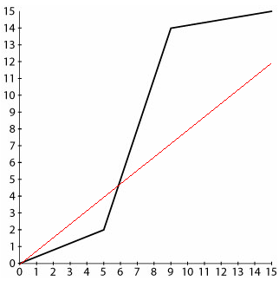
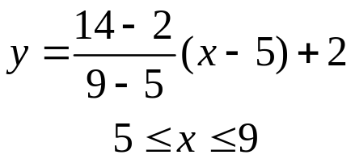
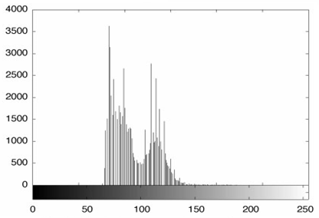
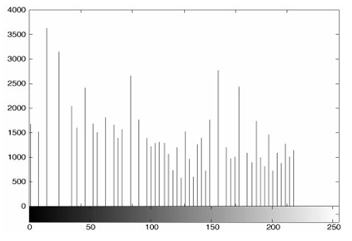
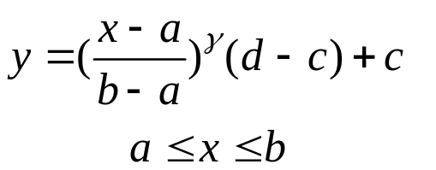
○ Contrast stretching
General form:
4-<number>
Notes:
會拉開

Slide 8
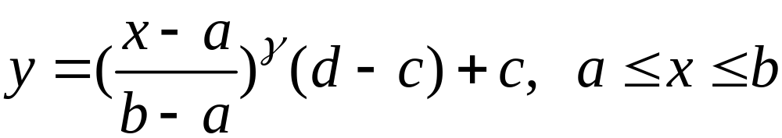
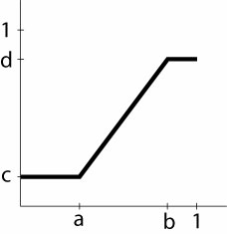
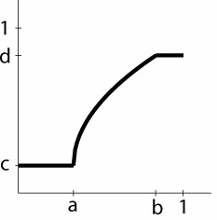
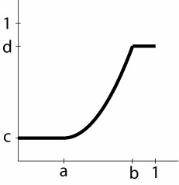




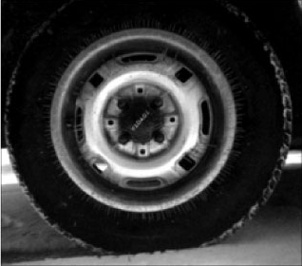
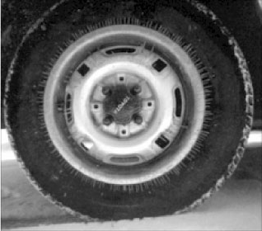
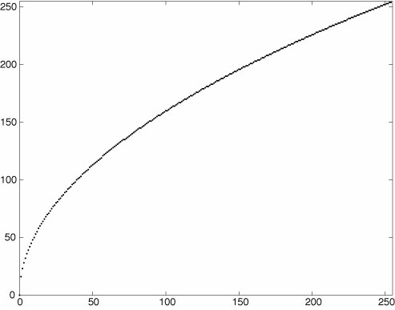
General form:
Input
Output
4-<number>

Slide 9



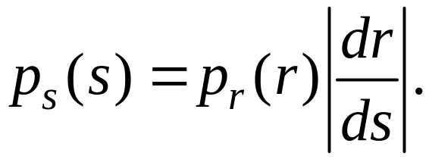
4.3.2 Histogram Equalization
-- Change the histogram of an image to one that
possesses a uniform distribution using as
a transformation function the accumulative
histogram of the image.
Theorem: Let T be a differentiable strictly increasing
or strictly decreasing function. Let r be a continuous
random variable having density Let
having density . Then,
4-<number>
Notes:
理論上要嚴格地遞增
實際上不用

Slide 10

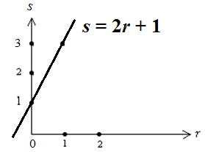
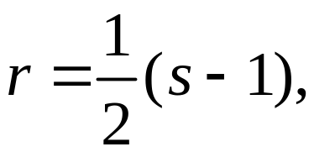
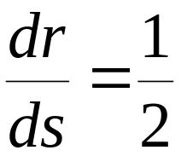
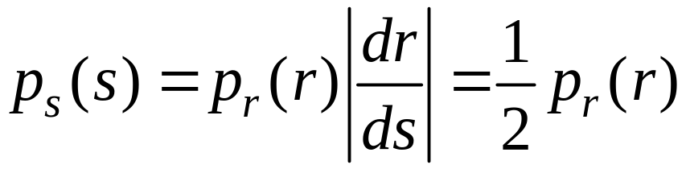

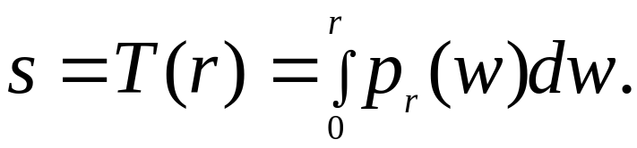

○ Example:
○ If the transformation function is the
cumulative distribution function of r, i.e.,
Called this equalization or linearization.
4-<number>

Slide 11
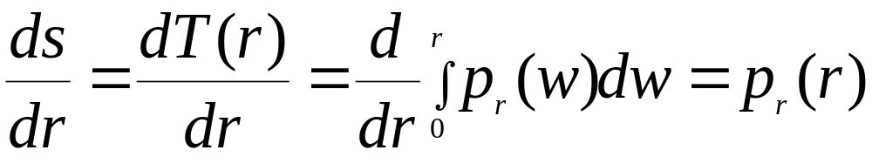
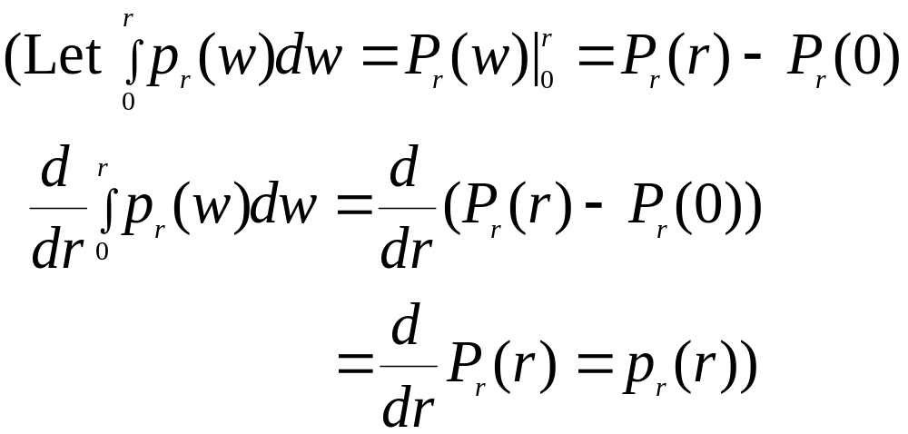
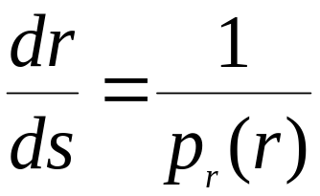
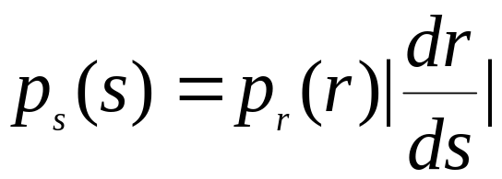
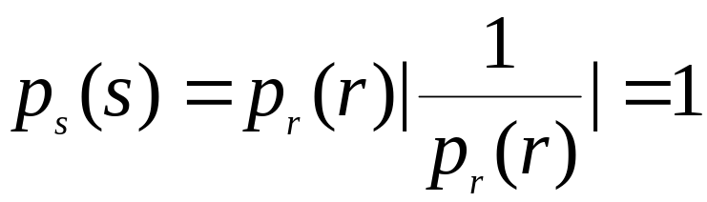
Proof:
From,
4-<number>

Slide 12
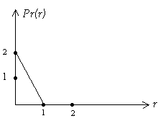
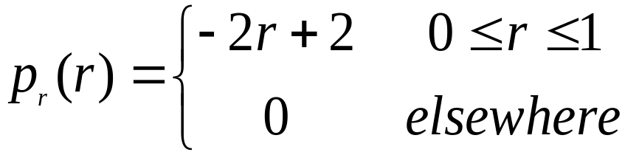
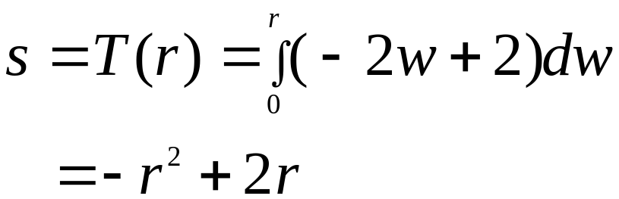
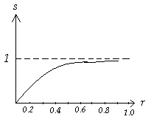
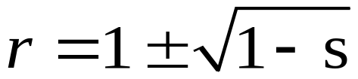
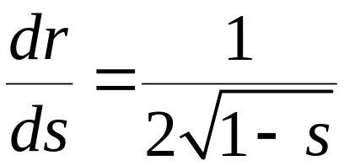
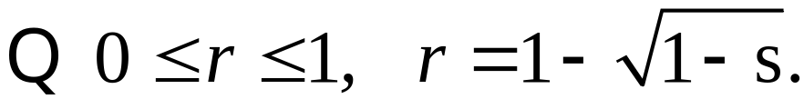
○ Example:
Let
4-<number>

Slide 13
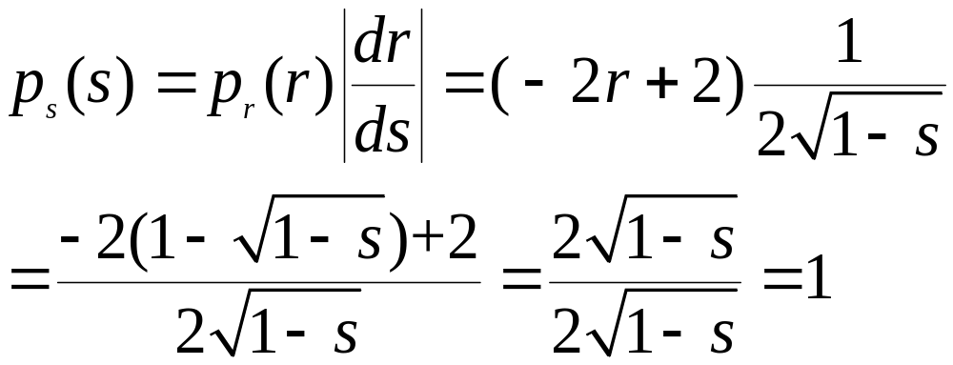
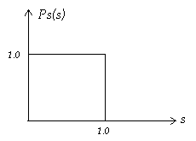





i.e., is a uniform distribution
○ Discrete case
Let
Transformation:
Scale
4-<number>

Slide 14




○ Example: L = 16, n = 360
4-<number>
Notes:
(L-1)*累積比例
灰階值要整數(故4捨5入)

Slide 15

○ Example:
4-<number>

Slide 16


○ Example:
4-<number>

